Slide 1
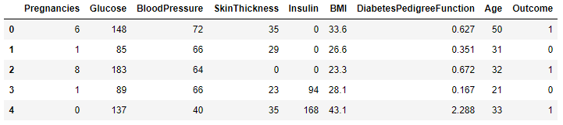
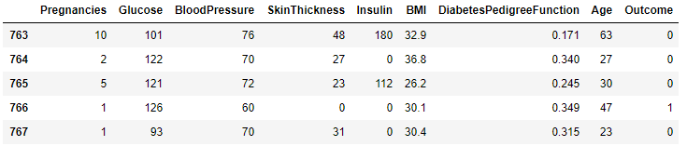
PIMA India Diabetes Analysis
Data Understanding
The dataset consist of 768 samples, out of which 500 are non diabetic while 268 are diabetic people
All patients are females of at least 21 year of age
The dataset has total 9 attributes out of which 8 are independent variables and one is the dependent variable
Top 5 records – df.head()
Last 5 records – df.tail()

Slide 2
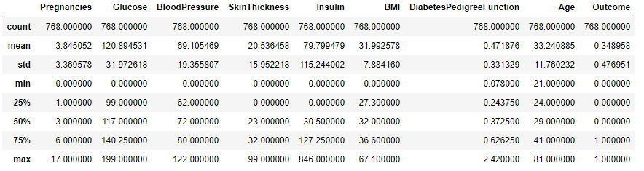
Describe the variable
Out of 768 sample records approximately 35% of patients are diabetic

Slide 3
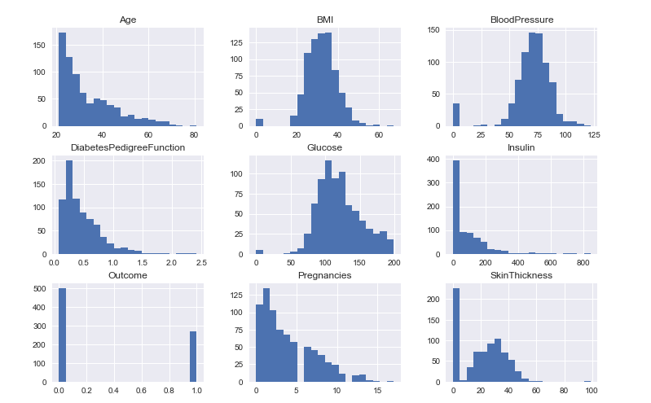
Visualization :
Univariate, Histograms

Slide 4
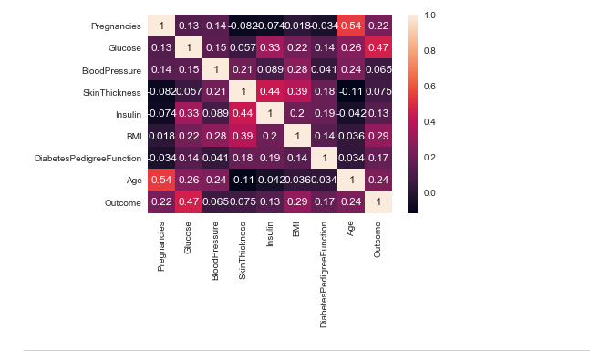
Correlation Matix
* correlation map - shows Glucose as the highest probability with 47%

Slide 5
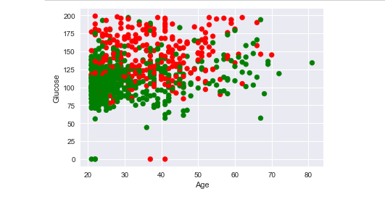
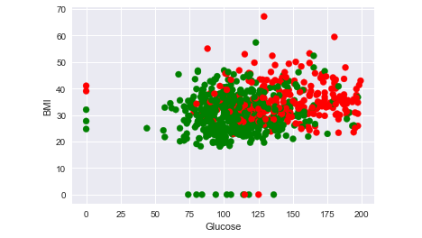
Scatterplot

Slide 6
Discover rules
Glucose and BMI for is larger for patients having diabetes.
Patients with Glucose greater than 140 mg/dl and BMI greater than 25 has the higher chances of getting diabetes
Age greater than 40 and Glucose count greater than 140 mg/dl has the higher chances of getting diabetes
Glucose
Normal - 140 mg/dl
Pre-diabetes - 140 to 199 mg/dl
Diabetes - 200 mg/dl and more
BMI
Normal - 18.5 to 25
Overweight range - 25 and 30
Obese Range - > 30
Reference link to the github
https://github.com/jacobmat/DataAnalysis-Projects

Slide 7
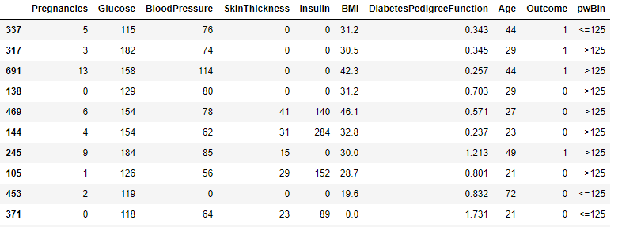
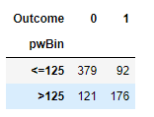
Bin Variable creation
Discovering Glucose as the main variable effecting the diabetes – further analysis was done based on Pivot creation and Train/Test data creation
Pivot preparation
Model:
- Overall 35% of patient has diabetes (278/768)
If Glucose < =125 then diabetes chances = 34% (92/278)
- If Glucose > 125 then diabetes chances = 66% (176/278)

Slide 8
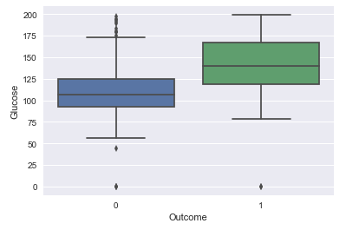
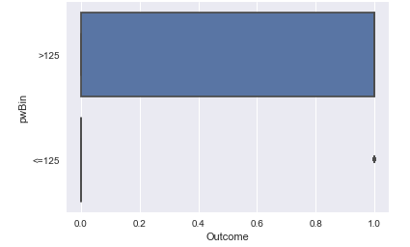
Train/Test Sample preparation
Out of Total 768 rows * 10 Columns records;
80% Train data : 614 rows * 10 Columns
20% Test data : 154 rows* 10 Columns
Plot Box

Slide 9
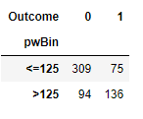
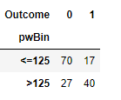
Pivot on Train Data
Pivot on Test Data
As per the baseline data we analysed that Glucose is like to be the main reason for diabetes
Baseline data shows that 35% of patient has diabetes and 65% doesn’t have diabetes in the sample set
Train data shows if the Glucose is >125 then 64% chances of getting diabetes
Test data shows if the Glucose is >125 then 70% chances of getting diabetes
Model is with accuracy of 84% {(64-35)/35%}

